Slide 1

Specialization
Net 9.0, ASP.Net Core 9.0
C# 12.0, WPF 4.5 .2 with Blend
ASP.Net MVC 9.0 & Micro services
Blazor, gRPC, Asp.net Web API
Python 3.14 with CICD, Shiny tool
DevOps, GIT, Jenkins, Docker
Adv. Python,Django, Flask, AWS admin
Claude, Gen AI, Agentic AI with MCP
Java, HTML 5, CSS 3, SASS, Bootstrap
React 19.0 with Typescript & Zustand
Micro-services in python with Fast API
ES 6, Jquery 3.x,D3.js,GraphQL with Apollo
Advanced Next js with OpenAI, LLM,CMS
Github Copilot,Typescript, Angular 22
Haxe , Vue js, Oracle Jet, Open UI 5
React 19.x & Redux , React Native
Rust Language, analogjs, svlete,
Node js, Mongo DB,JSON,YAML, TOML
Mocha, Jasmine,Protractor, Karma
Docker, Webpack, Grunt, Gulp,
Fast API
Complete the pre-test
Dr. D.S.R.Murthy M.Tech (IT)
Project Mentor & Corporate Trainer
Experience : 34 years

Slide 2
Python 3.x
Python is easy to learn, highly readable, and simple to use
Python programming is platform independent (mac/windows/linux)
Python is one of the preferred programming languages for working in Test Automation, Web Scraping, Data Analytics, and Machine Learning domains
Modules:
pandas, numpy ,scipy ,scikit-learn , matplotlib, tensorflow, seaborn, beautifulsoup……
DSR Murthy
Dr. DSR Murthy

Slide 3
Python
“Python” or “CPython” is written in C/C++
“Jython” is written in Java for the JVM
“IronPython” is written in C# for the .Net environment
DSR Murthy
Dr. DSR Murthy

Slide 4
Python Versions
Python Version Release date:
Python v0.1.0 (The First Edition) - 1990
Python v0.9.5 (Macintosh support) - 1992
Python v1.0.0 - 26th Jan’1994
Python v1.1.0 - 26th Jan’1994
Python v1.2.0 - Apr’1995
Python v1.3.0 - Oct’1995
Python v1.4.0 - Oct’1996
Python v1.5.0 - 3rd Jan’1998
Python v2.0.0 (Added list comprehensions) - 16th Oct’2000
Python v2.7.0 - 3rd Jul’2010
Python v3.0.0 - 3rd Dec’2008
Python v3.6.6 - Jun’2018
Python ………..
Python 3.14.x
DSR Murthy
Dr. DSR Murthy

Slide 5
Why Use Python?
Python
Python is object-oriented
Python supports polymorphism, operation overloading, and multiple inheritance
It's free (open source)
Online Python community is huge
It's portable – Supported on mac , windows and Linux
It's powerful
Dynamic typing
Built-in types and tools
Third party utilities (e.g. Numeric, NumPy, SciPy)
Automatic memory management
DSR Murthy
Dr. DSR Murthy

Slide 6
Python 3.14 new features
Faster Cpython - (10 to 60% faster than 3.10 version)
Better error messaging (Interpreter points to exact expression that caused error – traceback.
add_note() exception (e.add_note(‘some issue’)) which is available in traceback
Exception group and except* : make group and raise them together.
New features related to typing system. def Show(sql:literalStrig):void - here only literal strings should be passed to sql so that type checker checks to avoid injection attacks.
New module is added called tomllib for support .toml configuration files which is used in build systems of python projects now.
asyncio.taskGroup() is added which holds group of tasks to execute
New math functions – math.cubert(8) and math.exp2(4)
And many more at runtime level internally
Dr. DSR Murthy

Slide 7
Project Creation with environment
c:>md pythontraining
c:\> cd pythontraining
c:\pythontraning>python –m venv venv
c:\pythontraining> cd venv/scripts
c:\pythontraining> activate.bat
(venv) c:\pythontraining\calcapp>python –V
(venv) c:\pythontraining\calcapp>pip --version
(venv) c:\pythontraining\calcapp>pip install requests
(venv) c:\pythontraining>pip freeze > requirements.txt
(venv) c:\pythontraining\calcapp>venv/scripts/deactivate.bat
Dr. DSR Murthy

Slide 8
Project Creation with environment
c:>md bankapi
c:\> cd bankapi
c:\bankapi>python –m venv env
c:\bankapi> cd env & (cd scripts)
C:\bankapi\env\scripts> activate
(env) c:\bankapi>pip install fastapi
(env) c:\bankapi>pip freeze > requirements.txt
(eenv) c:\bankapi>venv/scripts/deactivate.bat
Dr. DSR Murthy

Slide 9
Virtual Environment in Python
1.venv module (requirements.txt)
> python –m venv myenv
2. pip install virtualenv
>virtualenv myenv
3. Pipenv (pip install pipenv)
>pipenv shell
pipfile is like package.json
Python 3.14.4
Python 3.10.5
Python 3.8.5
Global module
To create virtual environment for
particular version: example 3.9
$ virtualenv myenv --python=python3.10
BankApp
CustomerApp
Python 3.14.4
sdk
Flask
Requests
………..
Python 3.8.5
Django
pipfile

Slide 10
Multiple versions o python
C:\>where python (shows all installations of python)
C:\> python –V (Current python version used)
C:\myapp>python3.6 -m venv env
For particular version: python version 3.10.8:
https://www.python.org/downloads/release/python-3108/
(install 64bit msi file)
Reopen cmd to see new version
c:\myapp>python3.10.8 -m venv venv (create venv with 3.10)
Dr. DSR Murthy

Slide 11
Development Environment (IDE’s)
1. PyDev with Eclipse
2. Spider (Comes with Anaconda)
3. Visual Studio Code
4. Vim
5. TextMate
6. Gedit
7. Idle
8. NotePad++ (Windows)
9.BlueFish (Linux)
10.PyCharm (Licensed)
Dr. DSR Murthy

Slide 12
Fast API

Slide 13
Swagger
ENTRY.py
Configured API routes
Greet
Localhost:8000/greet
Customers
Localhost:8000/customers
Pruducts
Localhost:8000/customers

Slide 14
API
Definition
An API (Application Programming Interface) is essentially a set of rules and protocols that allows different software applications to communicate with each other.
It is a bridge that connects different systems or services, enabling them to share data and functionalities without directly interacting with each other's underlying code
Ex: Weather app
ASGI Server
API Call
Http
Database
get
post
put
delete
API Clients
Fast API with starlette and Uvicorn

Slide 15
Fast API with Starlette
FastAPI is built on top of Starlette.
Starlette provides the ASGI framework, routing, middleware, and request/response handling, while FastAPI adds API-focused features such as automatic validation, dependency injection, and OpenAPI documentation.

Slide 16
What is ASGI?
A – Asynchronous
S – Server
G – Gateway
I – Interface
ASGI (Asynchronous Server Gateway Interface) is the standard interface between Python web applications/frameworks and web servers.
It is the successor to WSGI (Web Service Gateway Interface) and was designed to support asynchronous programming.
An ASGI framework lets application handle many client requests concurrently without blocking, making it well suited for modern web applications, APIs, WebSockets, and real-time services.

Slide 17
ASGI Architecture
Client (Browser/Postman)
HTTP/WebSocket Request
Uvicorn (ASGI Server)
Fast API/ Starlette
ASGI Framework
Business Logic/DB
Http Response

Slide 18
Starlette vs FastAPI
Feature | Starlette | FastAPI
Purpose | Lightweight ASGI framework | High-level API framework
Built On | ASGI | Starlette
Route Declaration | Route() objects | @app.get(), @app.post() decorators
Data Validation | Manual | Automatic using Pydantic
Type Hints | Optional | Core feature
OpenAPI/Swagger | ❌ Not built in | ✅ Automatic
ReDoc | ❌ | ✅ Automatic
Dependency Injection | ❌ | ✅ Built-in
Request Parsing | Manual | Automatic
Response Models | ❌ | ✅
Authentication Utilities | Manual | Rich ecosystem
Middleware | ✅ | ✅ (inherits Starlette)
Background Tasks | ✅ | ✅
WebSockets | ✅ | ✅
Performance | Excellent | Excellent (very similar)
Learning Curve | Lower-level | Easier for API development

Slide 19
Starlette
Performance
Both frameworks are built on Starlette and are extremely fast. In most real-world applications, performance differences are negligible.
When to Choose Starlette:
Choose Starlette if you are building:
A lightweight ASGI application
Middleware
WebSocket servers
A custom framework
A low-level async service where you want full control

Slide 20
FastAPI
Choose FastAPI for:
REST APIs
Microservices
Backend services
AI/ML model serving
Enterprise APIs
CRUD applications
Projects that benefit from automatic validation and documentation

Slide 21
FastAPI vs Starlette
Advantages of FastAPI
Automatic request validation
Automatic OpenAPI generation
Interactive Swagger UI
Pydantic model integration
Dependency injection
Cleaner, less repetitive code
Strong editor support through type hints
Advantages of Starlette
Minimal and lightweight
Greater control over the request lifecycle
Excellent foundation for custom frameworks
Lower overhead in simple applications

Slide 22
FastAPI vs Starlette
Recommendation
For most application development—especially CRUD APIs, microservices, and production REST services—FastAPI is the better choice because it builds on Starlette while providing automatic validation, documentation, and many productivity features.
Gateway
Booktkt()
.,…
middleware
Auth
Logger
Caching
Routing
Versioning
hotelbook()
.,…
Client
Server

Slide 23
API – Key Features
Enable different systems, platforms, and applications to communicate and share data effortlessly
Significantly reduce the time and effort required to develop applications by leveraging pre-built functionalities
Enable systems to scale and adapt to growing or changing requirements
APIs contribute to creating dynamic and responsive applications that offer better user experiences
Allow organizations to expand their ecosystem and collaborate with external developers and partners
APIs provide controlled and secure access to data, allowing organizations to share information with clients, partners, or the public
APIs provide mechanisms to enforce security policies and ensure compliance with industry standards
APIs can help organizations reduce operational and development costs

Slide 24
Types of API
Web API:
APIs that are accessible over the web using HTTP/HTTPS protocols
Allow applications to communicate over the internet
Data is usually shared in JSON/XML formats
Examples:
Fetching weather data from OpenWeather API
Embedding Google Maps on a website
Library API:
APIs provided by libraries or frameworks to expose specific functionality for developers
Allow developers to utilize predefined functions or methods without implementing them from scratch.
Examples:
NumPy API: Provides functions for numerical computations
TensorFlow API: Offers tools for building and training ML/DL models
Matplotlib API: Allows creating visualizations programmatically

Slide 25
Types of API
Remote API:
APIs designed to interact with systems located on a different network or server, often through the internet or intranet
Web API is a subset of Remote API, i.e., all Web APIs are Remote APIs, but not all Remote APIs are Web APIs
Makes use of Intranet APIs, which can only be accessible within a private network
Examples:
Deploying virtual machines using AWS EC2 API
Retrieving remote files stored in Google Drive through its API
Database API:
APIs that allow applications to interact with databases
Provide a structured way to perform CRUD (Create, Read, Update, Delete) operations on a database
Examples:
MySQL Connector API: Enables interaction with MySQL databases
MongoDB API: Allows CRUD operations on NoSQL data

Slide 26

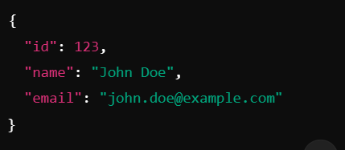
API Protocols
REST:
Abbreviation for Representational State Transfer
It’s a lightweight architectural style that uses HTTP for communication
Follow a set of principles, such as statelessness and resource representation using URLs
Each API call is independent of the other
Use Cases: Web applications, mobile applications, and public APIs (e.g., Twitter API, GitHub API)
API Protocols
Common HTTP methods: GET, POST, PUT, DELETE

Slide 27
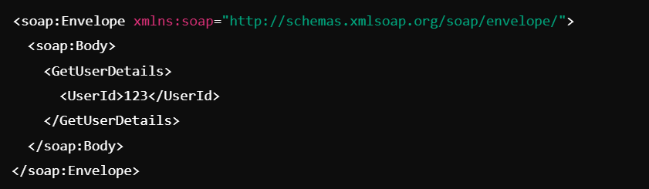
API Protocols
SOAP:
Abbreviation for Simple Object Access Protocol
A protocol that relies on XML messaging for communication
Designed for more structured and secure interactions
Has built-in error handling and security (e.g., WS-Security)

Slide 28
Working
Request Initiation:
The process begins when a client (like a web browser, mobile app, etc.) initiates a request to the API
This request is usually made using HTTP methods such as GET, POST, PUT, or DELETE
API Endpoint:
The request is sent to a specific URL known as an API endpoint
This endpoint is like a door that the API has opened for requests
Request Processing:
The server receives the request and processes it
This involves verifying the request parameters, checking authentication, and accessing databases, etc.
Response Generation:
After processing the request, the server generates a response
This response typically includes the requested data or a confirmation of the action performed
Response Delivery:
The response is sent back to the client
The client receives the response and uses the data to perform the desired action or display information to the user

Slide 29
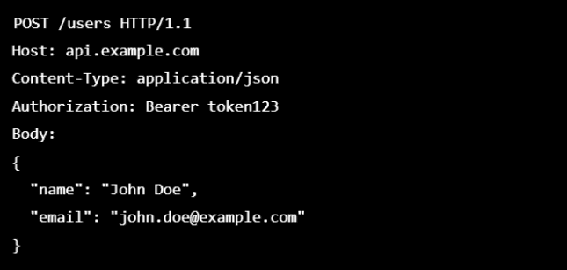
API
API Endpoints:
It’s a specific URL where the API can be accessed by a client to perform a certain action
Acts as the communication touch point between the client and the server
Usually include path parameters and query parameters
Request
Message sent by a client to the API to ask for information or perform an operation
Key components of a request:
Method: Specifies the type of operation (e.g., GET, POST, PUT, DELETE)
Headers: Provide metadata about the request, such as content type
Endpoint:
Contains the data being sent to the server

Slide 30
API
Response:
message sent back by the API after processing a client’s request
Key components of a response:
Status Code: Indicates the outcome of the request (e.g., success, error)
Headers: Metadata about the response, such as content type or caching instructions
Body: The actual data being returned, typically in JSON, XML

Slide 31
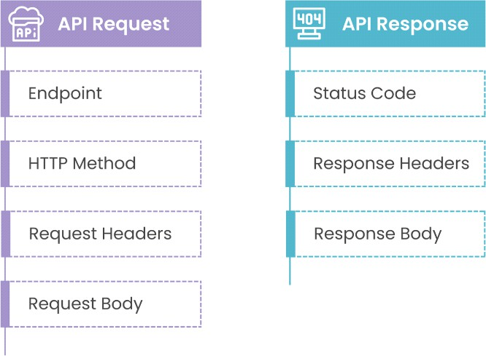
Working
Client
Web Server

Slide 32
API
Rate Limiting and Quotas
Mechanisms to control the number of requests a client can make within a specified time.
Mainly to prevent abuse and ensure fair usage
Headers for implementation:
X-RateLimit-Limit: Maximum requests allowed
X-RateLimit-Remaining: Requests remaining in the current window
Retry-After: Time to wait before retrying

Slide 33
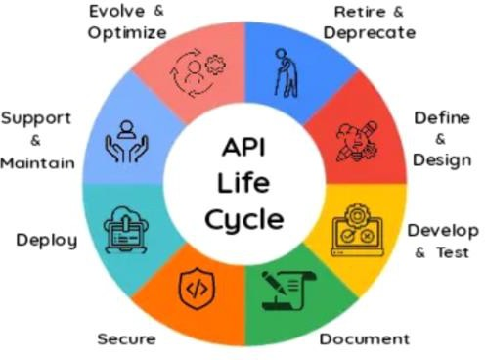
API Lifecycle
API Lifecycle
The API lifecycle refers to the comprehensive process of designing, developing, deploying, managing, and eventually retiring an API
It is a structured framework that ensures APIs are effective, scalable, secure, and meet business objectives

Slide 34
Planning & Design
Planning and Design:
Identify business goals, user needs, and the problems the API will solve
Determine the target audience: developers, partners, or internal teams
Define endpoints, request/response formats, and data models
Follow design methodologies like REST, GraphQL, or gRPC
Ensure adherence to API design best practices, such as intuitive endpoints, consistent naming, and proper versioning (CMM Level 5)
Tools: Postman, SwaggerHub, and Stoplight for API design and documentation

Slide 35
API Development
Development:
The development phase involves implementing the API's backend logic and infrastructure
Write the server-side code using programming frameworks like Flask, FastAPI, or Express.js
Integrate authentication and security mechanisms
Perform unit testing to validate individual functions and methods
Tools: Git, Jenkins, Docker, or Kubernetes for CI/CD pipelines

Slide 36
API Deployment
Deployment:
Involves releasing the API into a production environment where users can access it
Deploy the API to staging, testing, and production environments
Use cloud services like AWS, Azure, or GCP for scalability and reliability
Set up an API gateway to manage routing, caching, and load balancing
Popular gateways include AWS API Gateway, Kong ….

Slide 37
API Monitoring
Monitoring and Management:
Track performance metrics like response times, uptime, and error rates
Gather usage data to understand traffic patterns, popular endpoints, and user behavior
Identify areas for improvement or optimization
Enforce rate limiting to prevent abuse
Tools: Datadog, New Relic, splunk and Grafana

Slide 38
API Monitoring
Updates and Versioning:
Ensure new updates do not break existing clients
Provide clear migration paths if breaking changes are unavoidable
Notify users in advance of deprecated features or versions
Provide timelines and guidelines for transition
Retirement:
When an API no longer serves its purpose, it is retired or deprecated
Inform stakeholders and users about the API’s retirement well in advance
Provide tools or resources to help users transition to newer APIs
Archive or securely dispose of any stored data associated with the API

Slide 39
Fast API
FastAPI is a modern, high-performance web framework for building APIs with Python based on standard Python type hints.
It is designed to make it easy and fast to build efficient, production-ready APIs, especially those involving asynchronous I/O operations and data validation
For ML & Data Science Projects:
Wrapping ML models as APIs (/predict)
Serving pre/post-processing logic
Managing model versions and feature validation
For enterprise level secured API to expose business data

Slide 40
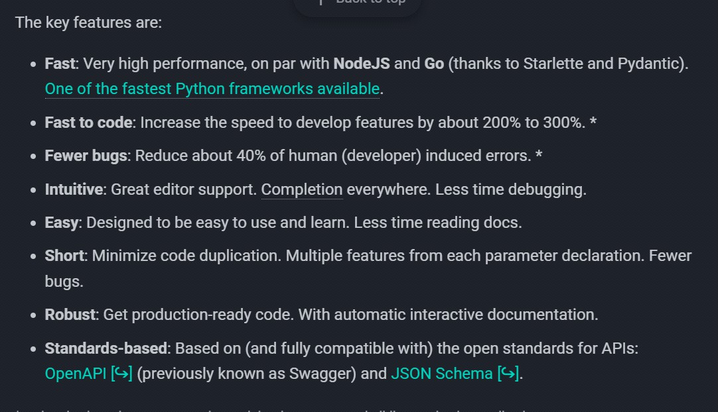
Fast API

Slide 41
Fast API
Starlette:
Lightweight ASGI web framework/toolkit used as the core web layer in FastAPI
Handles the registration and dispatching of HTTP routes (e.g., GET, POST)
Enables real-time WebSocket communication

Slide 42
Fast API
Pydantic:
Data parsing and validation library that leverages Python’s type hints to enforce and transform data structures
Ensures request bodies, query params, headers, and path params match expected types
Converts data (e.g., string to int, string to datetime) before it reaches your function
Helps auto-generate JSON Schema for documentation

Slide 43
Fast API
Uvicorn:
A lightning-fast ASGI server implementation based on uvloop and httptools
Launches FastAPI apps and handles incoming client requests
Communicates with FastAPI via the ASGI specification
Supports async I/O, which makes it fast and scalable

Slide 44
Comparison
FEATURE | FastAPI | Flask | Django | Falcon
Release Year | 2018 | 2010 | 2005 | 2013
Asynchronous Support | Native (async/await) | Limited (via extensions) | Partial (since Django 3 | Full
Performance | Very High (Starlette + async) | Moderate | Moderate | Very High
Type Hinting / Validation | Built-in with Pydantic | Manual | Manual or via DRF | Manual
API Documentation | Auto-generated (Swagger, ReDoc) | No (3rd-party plugins) | Yes (only with DRF) | No
ORM | None built-in (can use SQLAlchemy, Tortoise, etc.) | None built-in | Django ORM | None
Admin Interface | No | No | Built-in | No
Learning Curve | Easy (if familiar with type hints) | Very Easy | Steep (due to monolithic structure) | Medium
Best Use Cases | Modern APIs, ML apps, async microservices | Simple apps, prototyping | Large web apps, admin panels | Ultra-fast microservices, low-latency APIs
Community & Ecosystem | Growing fast | Mature, large | Very mature | Niche, smaller
Built-in Features | Light but powerful | Lightweight | Full-stack batteries-included | Very minimal
Project Structure | Flexible (modular) | Very flexible | Strict | Very flexible
Deployment Ready | (ASGI-ready) | (WSGI) | (WSGI & partial ASGI) | (ASGI/WGSI)

Slide 45
Fast API
Installation
Create/Activate a virtual environment
python –m venv env
cd env/scripts/activate
Install FastAPI and Uvicorn:
pip install fastapi uvicorn

Slide 46
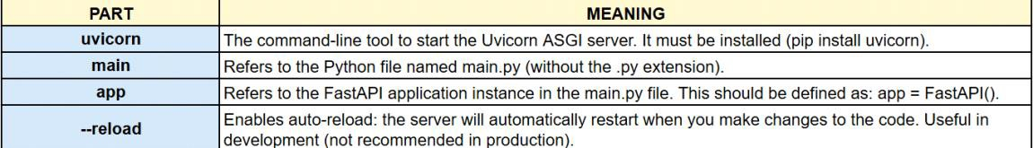
Fast API
First FastAPI App
Write the Python script (main.py)
Run the start-up command:
uvicorn main:app –reload - -workers=4
Telling uvicorn: Run the app object defined in the main.py file, and keep watching for any file changes so you can auto-reload the server

Slide 47
Fast API
Server starts at: http://127.0.0.1:8000
You can visit:
http://127.0.0.1:8000 → Your API endpoint
http://127.0.0.1:8000/docs → Swagger UI
http://127.0.0.1:8000/redoc → ReDoc docs

